Slide 1
Machine Learning
Support Vector Machines

Slide 2
Support Vector Machines
Here we approach the two-class classification problem in a direct way:
We try and find a plane that separates the classes in feature space.
If we cannot, we get creative in two ways:
We soften what we mean by “separates”, and
We enrich and enlarge the feature space so that separation is possible.

Slide 3
Support Vector Classifier
Imagine a situation where you have a two class classification problem with two predictors X₁ and X₂.
Suppose that the two classes are “linearly separable” i.e. one can draw a straight line in which all points on one side belong to the first class and points on the other side to the second class.
Then a natural approach is to find the straight line that gives the biggest separation between the classes i.e. the points are as far from the line as possible
This is the basic idea of a support vector classifier.

Slide 4
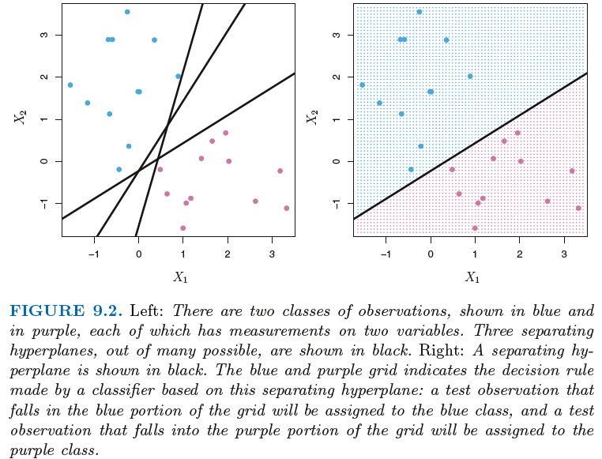
What is a Hyperplane?
A hyperplane in p dimensions is a flat affine (does not need to pass through origin) subspace of dimension p − 1.
In general the equation for a hyperplane has the form β₀ + β₁X₁ + β₂X₂ + . . . + β_{p}X_{p} = 0
In p = 2 dimensions a hyperplane is a line.
If β₀ = 0, the hyperplane goes through the origin, otherwise not.
If f (X) = β₀ + β₁X₁ + · · · + β_{p}X_{p}, then f (X) > 0 for points on one side of the hyperplane, and f (X) < 0 for points on the other.
If we code the colored points as Y_{i} = +1 for blue, say, and Y_{i} = −1 for purple, then if Y_{i} · f (X_{i}) > 0 for all i, f (X) = 0 defines a separating hyperplane.

Slide 5
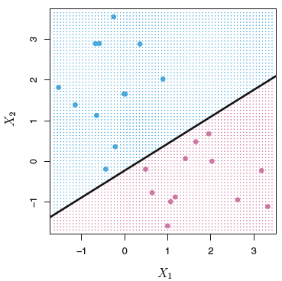
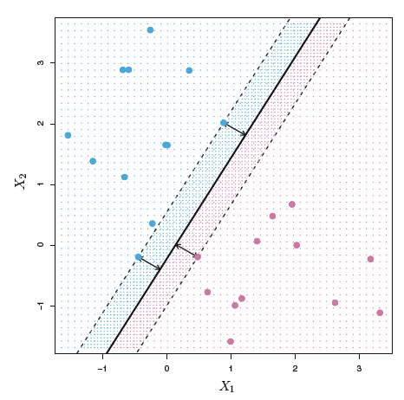
Maximal Margin Classifier
We can compute the (perpendicular) distance from each training observation to a given separating hyperplane; the smallest such distance is the minimal distance from the observations to the hyperplane, and is known as the margin
The maximal margin hyperplane is the separating hyperplane for which the margin is largest—that is, it is the hyperplane that has the farthest minimum distance to the training observations.
We can then classify a test observation based on which side of the maximal margin hyperplane it lies. This is known as the maximal margin classifier.
Support Vectors
They are called support vectors since they are vectors in p-dimensional space and they “support” the maximal margin hyperplane in the sense that if these points were moved slightly then the maximal margin hyperplane would move as well.
The maximal margin hyperplane
depends directly on the support vectors, but not on the other observations

Slide 6
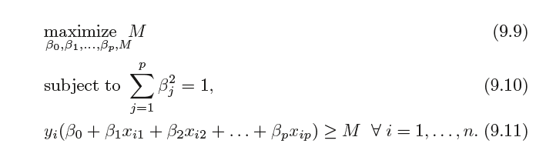
Maximal Margin Classifier
Among all separating hyperplanes, find the one that makes the biggest gap or margin between the two classes.
Constrained Optimization Problem
The constraints (9.10) and (9.11) ensure that each observation is on the correct side of the hyperplane and at least a distance M from the hyperplane. Hence, M represents the margin of our hyperplane, and the optimization problem chooses β0, β1, . . . , βp to maximize M

Slide 7
Non-separable Data
Noisy Data
^{X}2
−1.0 −0.5 0.0 0.5 1.0 1.5 2.0
3
3
2
2
X₂
1
X₂
1
0
0
−1
−1
−1 | 0 | 1 | 2 | 3 | −1 | 0 | 1 | 2 | 3
 |  | X₁ |  |  |  |  | X₁
0
1
2
3
^{X}1
The data on the left are not separable by a linear boundary.
This is often the case, unless N < p.
Sometimes the data are separable, but noisy.
This can lead to a poor solution for the maximal-margin classifier.

Slide 8
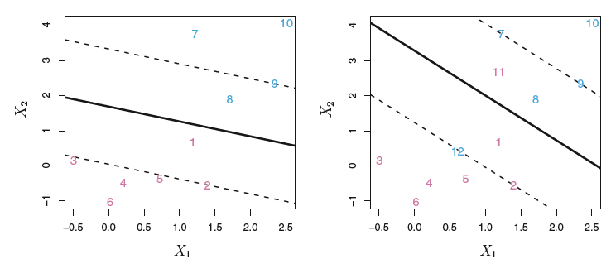
Support Vector Classifier
In this case, we might be willing to consider a classifier based on a hyperplane that does not perfectly separate the two classes, in the interest of:
Greater robustness to individual observations, and
Better classification of most of the training observations.
The support vector classifier, sometimes called a soft margin classifier, does exactly this.
Rather than seeking the largest possible margin so that every observation is not only on the correct side of the hyperplane but also on the correct side of the margin, we instead allow some observations to be on the incorrect side of the margin, or even the incorrect side of the hyperplane. (The margin is soft because it can be violated by some of the training observations.)

Slide 9
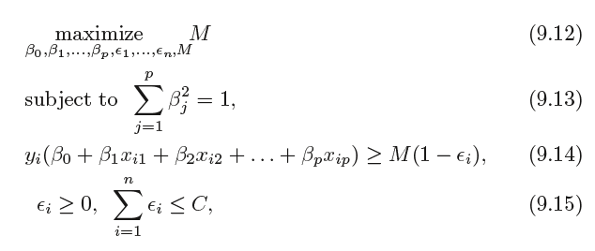
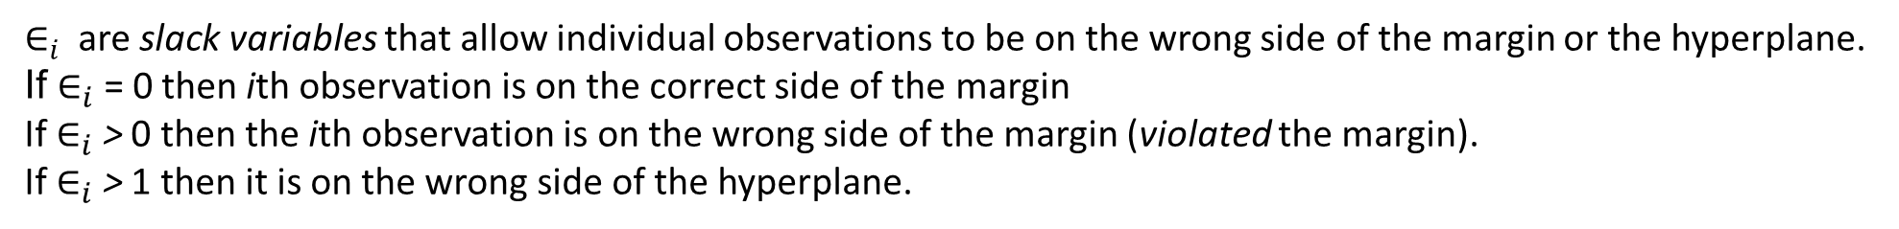
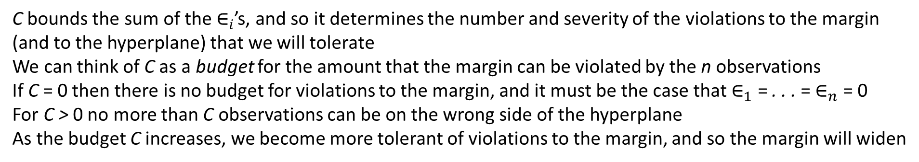
Support Vector Classifier
Constrained Optimization Problem
where C is a nonnegative tuning parameter
$∈_{i}$are slack variables that allow individual observations to be on the wrong side of the margin or the hyperplane.
If $∈_{i}$ = 0 then ith observation is on the correct side of the margin
If $∈_{i}$ > 0 then the ith observation is on the wrong side of the margin (violated the margin).
If $∈_{i}$ > 1 then it is on the wrong side of the hyperplane.
C bounds the sum of the $∈_{i}$’s, and so it determines the number and severity of the violations to the margin (and to the hyperplane) that we will tolerate
We can think of C as a budget for the amount that the margin can be violated by the n observations
If C = 0 then there is no budget for violations to the margin, and it must be the case that $∈_{1}$ = . . . = $∈_{n}$ = 0
For C > 0 no more than C observations can be on the wrong side of the hyperplane
As the budget C increases, we become more tolerant of violations to the margin, and so the margin will widen

Slide 10
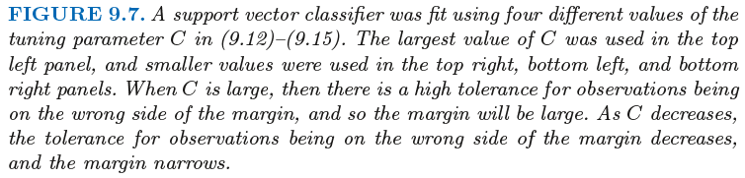
C is a regularization parameter
3
−3 −2 −1 0 1 2 3 −3 −2 −1 0 1 2 3
2
1
^{X}2
0
^{X}2
−1
−2
−3
−1
0
1
2
−1
0
1
2
^{X}1
^{X}1
3
2
1
^{X}2
−3 −2 −1 0
^{X}2
−1
0
1
2
−1
0
1
2
^{X}1
^{X}1

Slide 11
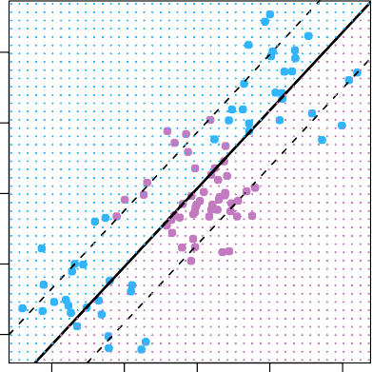
Linear boundary can fail
4
Sometime a linear boundary simply won’t work, no matter what value of C.
The example on the left is such a case.
What to do?
2
X₂
0
−2
−4
−4
−2
0
2
4
X₁

Slide 12
Feature Expansion
Enlarge the space of features by including transformations;
e.g. X² , X³, X₁X₂, X₁X²,. . .. Hence go from a
1 1 2
p-dimensional space to a M > p dimensional space.
Fit a support-vector classifier in the enlarged space.
This results in non-linear decision boundaries in the original space.
Example: Suppose we use (X₁, X₂, X₁ ², X₂², X₁X₂) instead of
just (X₁, X₂). Then the decision boundary would be of the form
β₀ + β₁X₁ + β₂X₂ + β₃X² + β₄X² + β₅X₁X₂ = 0
1 2
This leads to nonlinear decision boundaries in the original space (quadratic conic sections).

Slide 13
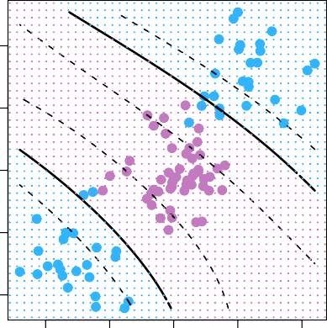
Cubic Polynomials
Here we use a basis expansion of cubic poly- nomials
From 2 variables to 9
The support-vector clas- sifier in the enlarged space solves the problem in the lower-dimensional space
4
2
X₂
0
−2
−4
−4
−2
0
2
4
X₁
β0 +β1X1 +β2X2 +β3X² +β4X² +β5X1X2 +β6X³ +β7X³ +β8X1X² +β9X²X2 = 0
1 2 1 2 2 1

Slide 14
Nonlinearities and Kernels
Polynomials (especially high-dimensional ones) get wild rather fast.
There is a more elegant and controlled way to introduce nonlinearities in support-vector classifiers — through the use of kernels.
The support vector machine (SVM) is an extension of the support vector classifier that results from enlarging the feature space in a specific way, using kernels.
Before we discuss these, we must understand the role of inner products in support-vector classifiers.
It turns out that the solution to the support vector classifier problem (9.12)–(9.15) involves only the inner products of the observations (as opposed to the observations themselves).

Slide 15



Inner products and support vectors
— inner product between vectors
The linear support vector classifier can be represented as
— n parameters α_{i} , i = 1, . . . , n, one per training
observation.
To estimate the parameters α₁, . . . , α_{n} and β₀, all we need
are the n(n-1)/2 inner products between all pairs of training observations
It turns out that α_{i} is nonzero only for the support vectors in the solution. That is, if a training observation is not a support vector, then its α_{i} equals zero
S is the collection of indices of these support points

Slide 16

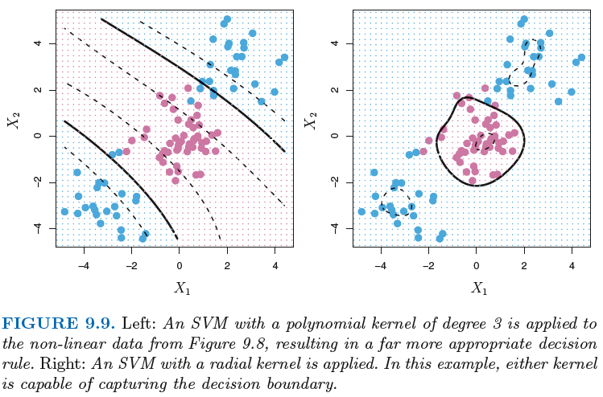


Kernel
Generalization of the inner product of the form K(x_{i}, x_{i’} )
A kernel is a function that quantifies the similarity of two observations
Linear Kernel
Polynomial Kernel
Radial Kernel
The support vector machine (SVM) is an extension of the classifier that results from enlarging the feature space in a specific way, using kernels.

Slide 17
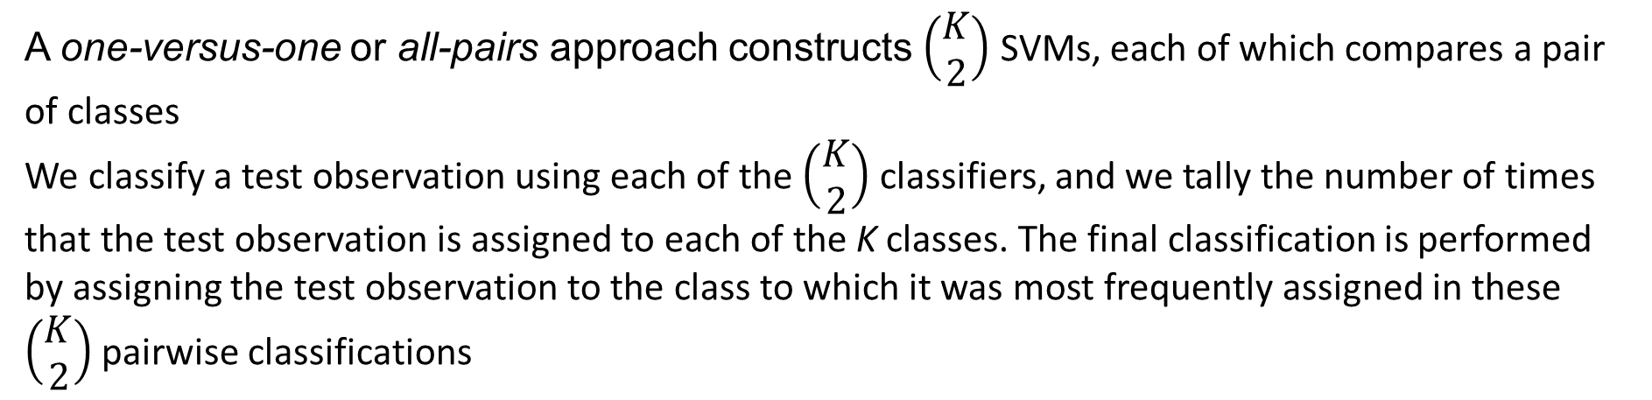
SVMs: more than 2 classes?
The SVM as defined works for K = 2 classes. What do we do if we have K > 2 classes?
OVA One versus All
We fit K SVMs, each time comparing one of all the K classes to the remaining K − 1 classes
Fit K different 2-class SVM classifiers f^{ˆ}_{k}(x), k = 1, . . . , K; each class versus the rest. Classify x∗ to the class for which f^{ˆ}_{k}(x∗) is largest.
OVO One versus One
A one-versus-one or all-pairs approach constructs $\left(\begin{aligned}K \\ 2\end{aligned}\right)$SVMs, each of which compares a pair of classes
We classify a test observation using each of the $\left(\begin{aligned}K \\ 2\end{aligned}\right)$ classifiers, and we tally the number of times that the test observation is assigned to each of the K classes. The final classification is performed by assigning the test observation to the class to which it was most frequently assigned in these $\left(\begin{aligned}K \\ 2\end{aligned}\right)$ pairwise classifications
Which to choose? If K is not too large, use OVO.

Slide 18
Which to use: SVM or Logistic Regression
When classes are (nearly) separable, SVM does better than LR.
When not, LR (with ridge penalty) and SVM very similar.
If you wish to estimate probabilities, LR is the choice.
For nonlinear boundaries, kernel SVMs are popular. Can use kernels with LR as well, but computations are more expensive.

Slide 19
Practice / HW
In this problem, you will use support vector approaches in order to predict whether a given car gets high or low gas mileage based on the Auto data set in the ISLR library.
(a) Create a binary variable that takes on a 1 for cars with gas mileage above the median, and a 0 for cars with gas mileage below the median.
(b) Fit a support vector classifier to the data with various values of cost, in order to predict whether a car gets high or low gas mileage. Report the cross-validated training dataset error associated with different values of this parameter. Comment on your results.
(c) Now repeat (b), this time using SVMs with radial and polynomial basis kernels, with different values of gamma (sigma) and degree and cost. Comment on your results.

Slide 20
Practice / HW
This problem involves the OJ data set which is part of the ISLR package.
(a) Create a training set containing a random sample of 60% of the observations, and a test set containing the remaining observations.
(b) Fit a support vector classifier with a linear kernel to the training data using cost=0.01, with Purchase as the response and the other variables as predictors. Describe the results obtained.
(c) What are the training and test error rates?
(d) Use a tuning grid in caret to select an optimal cost. Consider values in the range 0.01 to 10.
(e) Compute the training and test error rates using this new value for cost.
(f) Repeat parts (b) through (e) using a support vector machine with a radial kernel. Use a grid of values for gamma but use default for cost
(g) Repeat parts (b) through (e) using a support vector machine with a polynomial kernel. Tune degree and cost using a grid.
(h) Overall, which approach seems to give the best results on this data?

Slide 21
Reading
Chapter 9 in Introduction to Statistical Learning

